Slide 1
Cloud Native Data Flow Orchestration
Mark Fisher | Patrick Peralta
@m_f_ | @patrickperalta

Slide 2
Overview
Streaming and Batching with Spring XD
From modules to microservices
Orchestration by Spring Cloud Data Flow
Demos
Local
YARN
Lattice
Cloud Foundry

Slide 3
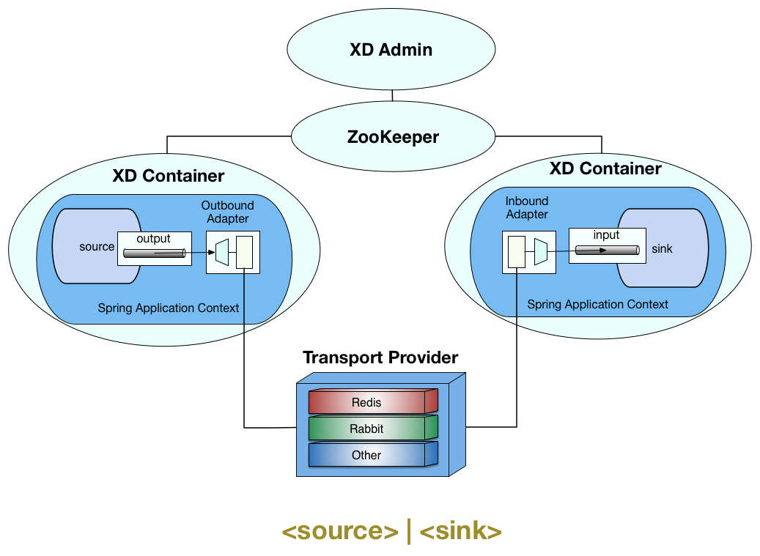
Streaming and Batching with Spring XD

Slide 4
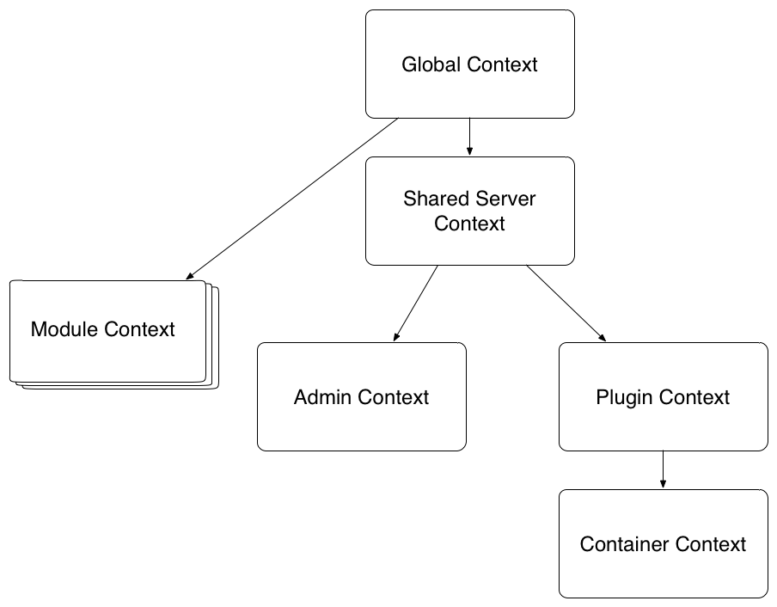
Spring XD Modules
Execute inside of a Spring XD Container
Consist of beans in an application context
Multiple modules may run in a container, each with their own class loader

Slide 5
Room For Improvement
Custom module development was somewhat complex
Classloader issues, jar proliferation in the lib directory
Feature requests for a more dynamic distributed runtime (scale up, down)
From | To
Modules | Microservices
Built in distributed runtime | Distributed runtime SPI (Cloud Foundry, Lattice, YARN)

Slide 6
STOP! Download Fonts Now.
PLEASE DOWNLOAD AND INSTALL THESE FONTS BEFORE CREATING YOUR PRESENTATION. You can download the fonts here…
https://www.dropbox.com/s/na8jewnsp8dp659/SpringOne-2015-Fonts.zip?dl=0
Fonts included in the ZIP file:
Proxima Nova (body text)
Domine (headlines)
http://www.fontspring.com/support/installing/how-do-i-install-fonts-on-my-mac
http://www.fontspring.com/support/installing/how-do-i-install-fonts-on-my-windows-pc

Slide 7
Contents
Title slide
Contents
Using this template
Intro
Inserting slide & applying layout
Layouts
Fonts
Colors
Notes for reviewers
Call to Action Slide
Logos and clip art
Logos
Event logos and icons
Project icons
Tool suite icons
Document icons
Additional icons
Clip art
Clip art

Slide 8
Using this Template

Slide 9
Intro
This template has been carefully prepared with specific layouts, colors, fonts and more. This short intro will outline the basic components of this template.
Note: This template includes slides with approved color palette, fonts, logos and clip art. It’s a good idea to keep these slides in order to quickly access these assets then delete the slides when you have finished creating your presentation.

Slide 10
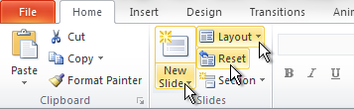
Inserting New Slides and Applying Layouts
To create different types of slides, select New Slide and apply desired Layout
If you make formatting changes to a slide and want to reapply the default settings, click Reset

Slide 11
Layouts
There are 13 layouts
Title Only – Standard slide with no text content box, do not use for section title
Title and Content (1 Col) – Standard slide with title and text content box
Title and Content (2 Col) – Standard slide with title and two text content boxes
Comparison – Standard slide with title and two text content boxes with subtitles
Section Title – Use between sections
No text
Table – Quick and easy way to get a table with brand colors
Bar Chart – Quick and easy way to get a bar chart with brand colors
Line Chart – Quick and easy way to get a line chart with brand colors
Pie Chart – Quick and easy way to get a pie chart with brand colors
Code Formatting – Quick and easy way to get preferred code formatting
Title Slide – Presentation title with author name and contact info. Use only once in presentation.
Completely blank – A totally blank, white slide. Use sparingly.

Slide 12

Fonts – Title Domine(30pt, DO NOT BOLD)
All body text is Proxima Nova Regular
Subhead (18pt)
Level Two (18pt)
Level Three (18pt)
Level Four (18pt)
Use the “Decrease/Increase Indent” tools to change bullet levels
Click on the Home ribbon, Paragraph tab
Line spacing is set in master slides

Slide 13
Brand Colors
SpringOne 2GX 2015
Theme Colors
Spring
Brand Colors
R: 12
G: 48
B: 100
R: 149
G: 0
B: 0
R: 156
G: 209
B: 121
R: 83
G: 83
B: 83
R: 109
G: 179
B: 63
R: 38
G: 97
B: 168
R: 198
G: 64
B: 64
R: 204
G: 204
B: 204
R: 241
G: 241
B: 241
R: 153
G: 153
B: 153
R: 52
G: 48
B: 45
R: 114
G: 163
B: 211

Slide 14
Code Slide
// This is Helvetica: 18 pt or higher please
public class TransferServiceImpl implements TransferService {
public TransferServiceImpl(AccountRepository ar) {
this.accountRepository = ar;
}
…
}

Slide 15
Notes for Reviewers
To provide comments, click the speech icon.
If you're viewing this deck online, the icon is in the footer
If you're a collaborator, the icon is on the lower left hand side
To view the proposed dialog for each slide, you need to be added as a collaborator, login to SlideShare, then View > Show Notes.
To be added as a collaborator (which also allows slide editing), please setup a SlideRocket account with your VMware address and email Ben.

Slide 16




Learn More. Stay Connected.
@springcentral
Spring.io/video
<Your CTA>
<Related Session>

Slide 17
Logos and Clip Art

Slide 18






Logos

Slide 19





Event Logos and Icons
Logo on dark
Logo on light
Date logo on dark
Date logo on light

Slide 20


















Spring Project Icons
Spring
Framework
Spring
Security
Spring
Data
Spring
Batch
Spring
Integration
Spring
Reactor
Spring
AMQP
Spring
Hateoas
Spring
Mobile
Spring
Android
Spring
Social
Groovy
Spring
Web Services
Spring
Web Flow
Spring
XD
Spring
Boot
Spring
LDAP
Grails

Slide 21




Spring Tool Suite Icons
Spring Tool Suite
Groovy / Grails Tool Suite

Slide 22












Spring Document Icons
Spring Framework
Support
Tools
Guides
Tutorials
Reference App

Slide 23



















Additional Spring Icons
Continuous
Integration
Issues
Metrics
Forums /
Discussion
Blog
@
All
Author
Broadcast
Date
Engineering
News
Event
Releases
Apple
Linux
Windows
Professional
Support
Community
Support
Location

Slide 24
Miscellaneous Icons

Slide 25


































Icon Guidelines
These icons can be used when Spring icons are not appropriate.
Max icon size is 2.08 inches – anything larger and the icon will be blurry
Icons are transparent and can be placed over images and other objects
To use an icon, simply choose, copy and paste
Max icon size:
2.08 inches

Slide 26





















































































































































































Slide 27





















































































































































































